Slide 1


Slide 2
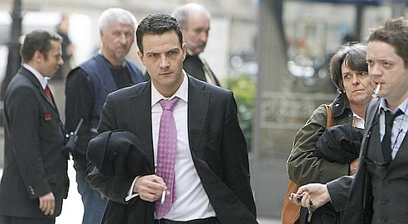

Slide 3
Jerome Kerviel

Slide 4
The Incident

Slide 5
Incident
Jerome Kerviel
Question: What happens when you mix an ambitious young trader, with an intimate knowledge of front-to-back procedures, a supervisor who didn't know much about trading and an environment without the proper trading controls?
Answer: A perfect financial storm worth billions of euros ... in losses.
5

Slide 6
Incident
Jerome Kerviel
This perfect financial storm is where Société Générale, France’s second largest bank, found itself on January 24, 2008. According to the press release the bank published on their website early that morning:
6

Slide 7
Incident
Jerome Kerviel
“Société Générale has uncovered a fraud, exceptional in its size and nature: one trader, responsible for plain vanilla futures hedging on European equity market indices, had taken massive fraudulent directional positions in 2007 and 2008 beyond his limited authority. Aided by his in-depth knowledge of the control procedures resulting from his former employment in the middle-office, he managed to conceal these positions through a scheme of elaborate fictitious transactions. Given the combination of the size of the positions and the very unfavorable market conditions encountered, this fraud has a negative impact on Euro 4.9 bn...".
7

Slide 8
Incident
Jerome Kerviel
To be precise the amount is 4,915,610,154 euro [R3]. This figure is astronomical: it represents the largest trading loss in banking history.
As a comparison, the loss incurred by famous rogue trader Nick Leeson, which sent Barings Bank into bankruptcy in 1995, was 850 million pounds sterling [R4]. Moreover, the notional of Kerviel’s un-authorized trades amounted to 50 billion euro in January 2008 – far larger than the total market capitalization of the whole Société Générale at the time.
8

Slide 9
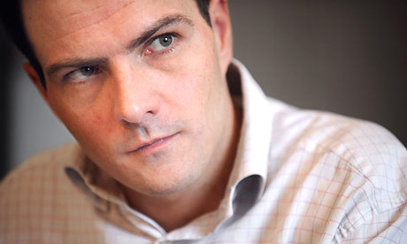

Slide 10
“… dans une sale de marches, le modus operandi idéal tient en une phrase: savoir prendre le maximum de risques pour faire gagner la banque le maximum d’argent. Au nom d’une telle regle, les principes les plus elementaires de prudence ne present pas lourd.”

